Slide 1


Leadership for Transformation: Mobilising Political Will and Institutional Commitment for Effective Tax Systems.
Economic Governance and Knowledge Management Vice Presidency
African Development Bank Group
September 2025

Slide 2

Overview
Imperatives of DRM for Africa’s Development
PRESENTATION OUTLINE
Opportunities and Reforms for Boosting DRM in Africa
1
4
Roles of the African Development Bank in Scaling Up DRM in Africa
State of DRM in Africa – Performance and Trends
2
5
3
6
Challenges in Mobilising Domestic Resources in Africa
Political will and institutional commitment for effective tax systems
Conclusion

Slide 3
Imperatives of DRM for Financing Africa’s Future

Slide 4
Domestic Resource Mobilisation as an Imperative for Africa’s Development
01
US$1.3 trillion - Annual financing required to achieve SDGs by 2030 in Africa
02
US$3.1 trillion – Continent's GDP in 2023 (AEO)
03
Taxation is the main source of revenue and finance and is critical to addressing current debt vulnerabilities
04
Taxation remains far below its potential affecting revenue mobilisation
05
African Union’s (AU) Agenda 2063, the Bank’s High-5 priorities and Ten-Year Strategy 2.0, SDGs have Domestic Resource Mobilisation as a priority

Slide 5
Sources of Finance for Africa’s Development
US$1.3 trillion - Annual financing required to achieve SDGs by 2030 in Africa
US$3.1 trillion – Continent's GDP in 2023 (AEO)
Taxation is the main source of revenue and finance and is critical to addressing current debt vulnerabilities
Taxation remains far below its potential affecting revenue mobilisation
African Union’s (AU) Agenda 2063, the Bank’s High-5 priorities and Ten-Year Strategy 2.0, SDGs have Domestic Resource Mobilisation as a priority

Slide 6
State of DRM in Africa – Performance and Trends

Slide 7
State of Domestic Resource Mobilisation in Africa – Performance and Trends
Mobilisation of revenues in Africa
Panel A. Tax revenue levels across the globe
Panel B. Total government revenue by region
Reflecting the diverse economic landscapes within the continent, revenue ratios vary considerably across regions and countries, with significant variations between non-oil and oil dependent, as well as ADF vs non-ADF countries
Only 21 RMCs countries had tax revenues above the 15% minimum required to finance SDGs.
Revenues are recovering post-COVID, but remain lower than levels recorded a decade ago

Slide 8
State of Domestic Resource Mobilisation in Africa – Performance and Trends
Panel A. Tax revenue by region
Panel A. Tax revenue
Panel B. Government revenue
Panel B. Government revenue by region

Slide 9
State of Domestic Resource Mobilisation in Africa Performance and Trends
Africa Domestic Capital Markets
29 stock exchanges in Africa, representing the capital markets of 38 countries
Largest include South Africa Morocco, Egypt, Nigeria, Botswana and Namibia.
African frontier-market countries issued domestic bonds worth US$ 294 billion in 2020 from US$ 234 billion in 2019.
Average amount of bond issuances in 2021 increased to US$ 307 billion.
Small size economies
Unstable macroeconomic and business environment
Institutional and regulatory weakness underdeveloped financial infrastructures.
Current situation
Key Challenges

Slide 10
State of Domestic Revenue Mobilisation in Africa Performance and Trends
Africa’s pension and sovereign wealth funds
Despite the important role that pension funds and SWFs can play in promoting development, their management is a challenge for many African countries.
Opportunity to develop networks, partnership frameworks- pool resources from multiple pension schemes for greater impact
Informal sector coverage- less than 20% of Africans have pension coverage- need to expand and innovate with products that increase access
03
02
Investment Expertise and information is lacking- capacities need to be built within Pension Funds to manage their financial resources soundly and diversify portfolios, increase domestic investments
01

Slide 11
Challenges in Mobilising Domestic Resources in Africa

Slide 12
Challenges in Mobilising Domestic Resources in Africa
African economies continue to face significant challenges that hamper their ability to mobilize sufficient domestic resources
Proportion of the working population or economically dependent population
Degree of urbanization
Level of development
Debt levels
Rate of private investment,
Size of the manufacturing sector
Terms of trade
Access to private sector credit
Rate of inflation
Size of the informal sector
Political environment
Level of corruption
Economic environment (property rights, simplification of administrative procedures)
Administrative Capacity (tax administrations)

Slide 13
Challenges in Mobilising Domestic Resources in Africa
Tax Administration Diagnostic Tool (TADAT)
Public Expenditure and Financial Accountability (PEFA) Global Report 2022
Source: 55 TADAT assessments undertaken in African countries, ATAF, 2022
African Countries tax administration capacity is worse compared to other regions.
Weaknesses include: unreliable taxpayer registration base; under-utilization of digital technologies; ineffective risk management; unresponsiveness to taxpayer inquiries; unstructured processes and procedures; and weak accountability and transparency of tax administration operations

Slide 14
Opportunities and reforms for boosting DRM in Africa

Slide 15




Opportunities and reforms for boosting DRM in Africa
Tax reform programs should be country specific and informed by rigorous assessments such as the TADAT, and guided by well-defined Medium Term Revenue Strategies
Simplification of tax laws and regulations
Transparent and simplified tax regimes
Review of tax exemptions
Strenghthen Tax Adminstrative Capacity
Investments in HR capacity, IT systems, organisation, funding
Digitalization
E-declaration/filing and online payment systems; creation of citizens unique identifiers; integration into IFMIS; use of mobile money service for tax payments; use of portable devises to ease tax registration
Promote formalisation and implement comprehensive compliance improvement programs.
Taxpayer education, expansion of tax payment points, simplified tax regimes and expansion of services to MSMEs,
Options politiques pour stimuler la MRD en Afrique
Harmonization of fiscal policies at regional and continental levels
AfCTA, international tax treaties
Intensify the fight against tax evasion and illicit financial flows
Adherence to international standards, AEOI, Beneficial ownership registries, strengthening legal frameworks to address profit shifting, transfer pricing and tax evasion
Expand and diversify sources of taxation
Environmental and carbon tax, Property and High Net Worth Individuals taxation, E-commerce, taxation on harmful products- tobacco, alcohol, sugar etc,

Slide 16
Illicit Financial Flows (IFF)
Estimated loss due to IFF: $88.6 billion annually (UNCTAD).
Reduces domestic resource mobilization efficiency.
Key drivers: Tax evasion, corruption, and trade mispricing.
AfDB’s Action Plan 2024: Combating tax evasion and promoting transparency.

Slide 17
Roles of the African Development Bank in Scaling Up DRM in Africa

Slide 18




AfDB’s Role in Financial Architecture
Advocating for global financial reforms (e.g., SDR reallocation, AFFM establishment).
Promoting innovative financing tools: Green bonds, debt-for-climate swaps.
Supporting debt restructuring: Zambia, Ghana, Chad.
Strengthening African institutions for governance and transparency.

Slide 19
Roles of the African Development Bank in Scaling Up DRM in Africa
The Strategic Prioritisation of Domestic Resource Mobilisation
Ten-Year Strategy 1.0 (2013-2023) and 2.0 (2024-2033)
Creation of DRM plans in each country strategy papers
Reversal of illicit financial flows and improvement of natural resource management.
Strengthening of African institutions for transparency, accountability, and good governance
Strategy for Economic Governance in Africa (2021-2025):
Optimizing public revenue collection through taxation,
curbing the commercial elements of IFF
developing the financial sector to leverage domestic savings and investments
01
02
03
04
ADF Cycles 14, 15, 16
ADF commitments around ADF financing towards supporting operations that address DRM.
Policy on the Prevention of Illicit Financial Flows
Action Plan 2024

Slide 20
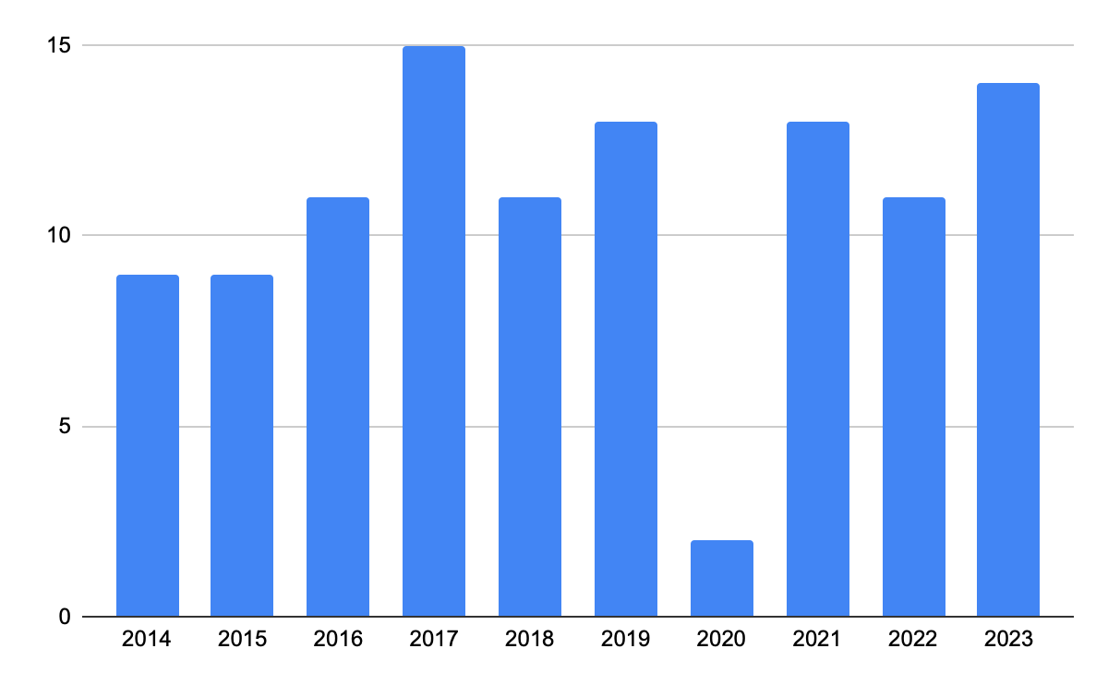
Roles of the African Development Bank in Scaling Up DRM in Africa
African Development Bank’s Support to Domestic Resource Mobilisation
Number of Bank Projects with DRM interventions, 2014-2023
108 operations at a total volume of UA 6.7 billion with at least one specific output aimed at domestic resource mobilization
Covering 45 of the Bank’s RMCs with 28 of them supported through at least two projects on the theme of DRM
Fifty-nine of the projects benefited lower-income African (ADF) countries while 44 were in middle-income African (ADB) countries.
Total number of operations | 108
Program-based operations (PBOs) | 66
Institutional Support Projects (ISPs) | 42

Slide 21
Roles of the African Development Bank in Scaling Up DRM in Africa
Targeted workstreams for Banks support to DRM
01
Digitalization and Technology in tax administration
02
Strengthening HR systems and capacity of tax & customs officers
03
Enhancing organization/ business processes of tax administrations
04
Customs Administration
05
Tax Legislation Reforms
06
Combatting Illicit Financial Flows- tax evasion and avoidance
07
Natural resources revenues transparency- EITI, FiTI

Slide 22
Roles of the African Development Bank in Scaling Up DRM in Africa
Examples of Bank projects in support of DRM:
Lesotho
Lesotho’s Tax Modernization Project (LTMP)- Increasing Efficiency of VAT
Enhancement of the performance and efficiency of Revenue Services Lesotho, through tax reforms, strengthening administration with focus on VAT compliance and collection
VAT tax gap reduced from 23 to 17 percent between 2015 and 2020
Namibia
Reforming revenue administration
Establishment of the Namibian Revenue Agency ( NAMRA) through the first phase of the Economic Governance and Competitiveness Support Program
Revenue-to-GDP ratio: improved from 30.8 percent in 2018, 32.7 percent in 2019, and 33 percent in 2020
Togo
Supporting Tax Administration and Capacity
Simplification of tax policies, modernization of tax administration systems and enhancement of tax collection.
Tax-to-GDP ratio increased from15.7% in 2005 to 19.5% in 2019.
Fiscal deficit decreased from 9.6% of GDP in 2016 to an estimated 2.2 per cent in 2019.

Slide 23
Roles of the African Development Bank in Scaling Up DRM in Africa
Examples of Bank projects in support of ATAF:
The Project improves tax transparency through technical
assistance to countries to undertake risk-based assessment of international companies and implementing automatic exchange for information for tax purposes. The Project will also support the long-term experts for ATAF’s Rapid Response Unit and the establishment of the Africa Tax Academy all of which are aimed at enhancing the delivery of technical support to countries. Other activities includes roll out of ATAF Women in Tax Network, development of a common Africa position on Tax Bases Erosion and Profit Shifting (BEPS).
Enhanced Capacity for Domestic Resource Mobilization under the Institutional Support Program Phase 2
(US$ 2.17 million)
ATAF developed an online ATO data portal and the ATAF databank to provide access to taxes and customs-related statistics to the public. This ATO data portal covered 35 countries so far but not yet fully covered the Central African Region. Between 2023 to 2025, AfDB supported the activity of collecting date.
African Tax Outlook (ATO) Data Collection support for Central African Region
(US$ 0.35 million)

Slide 24
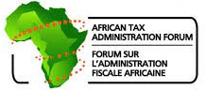








Roles of the African Development Bank in Scaling Up DRM in Africa
Bank’s collaboration with Partners on Improving Domestic Resource Mobilisation

Slide 25

Political Will and Institutional Commitment for Effective Tax Systems

Slide 26
LEADERSHIP FOR TRANSFORMATION– KEY ASPECTS
Sustain building capacities of the Tax authorities
Develop awareness campaigns to improve awareness for “Fiscal contract” between citizens and the STATE
Foster institutions capacity to make decisions and implement policies that deliver basic goods and services to citizens
Enforce compliance with the rule of Law and greater transparency of the Tax systems
Empower citizens to hold governments accountable through participation and decentralization
Avoiding the issue of natural “resource curse”, situation in which countries benefiting from important fiscal rents from the mining and oil sectors underperform in the collection of nonoil and / or mining revenue

Slide 27
LEADERSHIP FOR TRANSFORMATION – KEY ASPECTS
. Develop strategies and action plans for DRM within Tax administrations.
. Put in place efficient tools on monitoring and evaluation of Tax administration performance with sound Key Performance Indicators (KPIs).
. Ensure stable and predictable rules and institutions that regulate economic relations, enforce contracts and regulations, and promote investments.
. Establish efficient public private Dialogue Framework.
. Spur public policies which scale up private sector capacities to produce goods and services, hence providing jobs opportunities and widening the Tax base.

Slide 28

POLITICAL WILL AND INSTITUTIONAL COMMITMENT
Establish
Establish efficient and transparent Tax administration and Tax policy Frameworks
Streamline
Streamline the Tax structure to avoid heavy dependance on indirect taxes (especially VAT and import duties).
Adapt
Adapt tax policies and build institutional capacity to cope with the African Continental Free Trade Area (AfCFTA).
Seek
Seek legal advice on conventions in the mining and oil sectors (example from the African Legal Support Facility – ALSF).

Slide 29
Conclusion

Slide 30




CONCLUSIONS
Governments unwavering support to economic, financial and structural reforms, and enforcement of compliance with the rule of Law and greater transparency of their tax systems
Governments should establish efficient and transparent Tax administration and tax policies frameworks
Develop countries communications and IT Infrastructure and gear towards Full Digitalization of Tax administrations

Slide 31
THANK YOU
Economic Governance and Knowledge Management Vice Presidency
African Development Bank Group
Avenue Joseph Anoma
01 B.P. 1387 Abidjan 01
Côte d’Ivoire
www.afdb.org

