Slide 1

The CIAT Experience in Cooperating With Civil Society, Tax Advisors and Companies
Challenges & opportunities
Isaác Gonzalo Arias Esteban
International Cooperation and Taxation Director
September 2025

Slide 2
Q1: How is the culture of tax administrations changing? Q2: How does this affect tax organizations?

Slide 3
Old school TA culture
Everything is secret
Contact with stakeholders leds to corruption
Feedback from stakeholders is unconfortable
TA exists to control not to cooperate
New TA culture
Transparency when possible
Interation with stakeholders has positive impact
Feedback from stakeholders is useful
TA exists to control and cooperate
Impact in PTO
Open new cooperation opportunities
With what objectives?
Provide more and better products and services
Mantain more objective discussions
Promote voluntary compliance

Slide 4
Cooperation with Civil Society (CS)

Slide 5




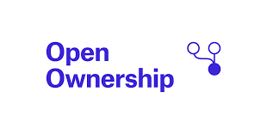


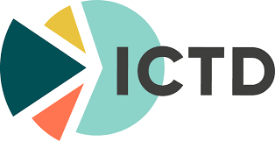




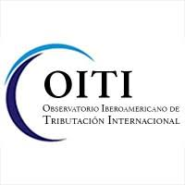

Slide 6
What CS are looking for?
Ideas to improve the tax system
Make their work known
Exert influence in desision´s makers
What do PTOs do?
Support tax administrations through products and services
Motivates dialogue between the tax administration and its stakeholders at regional/international level.
Cooperation opportunity
Develop new products, services and forums.
Use existing products, services, and forums.
Diseminate innovative ideas

Slide 7
Some Results
Executive Summary
1. Introduction
2. Trusts and the Abuse of Opacity
3. Trusts as a Tool to Avoid and Evade Tax Payments
4. Other Structures to Hide the Beneficial Owner and Avoid Taxes
5. Steps to Identify and Analyze a Complex Structure
6. Proposed Regulations
References
Appendix

Slide 8
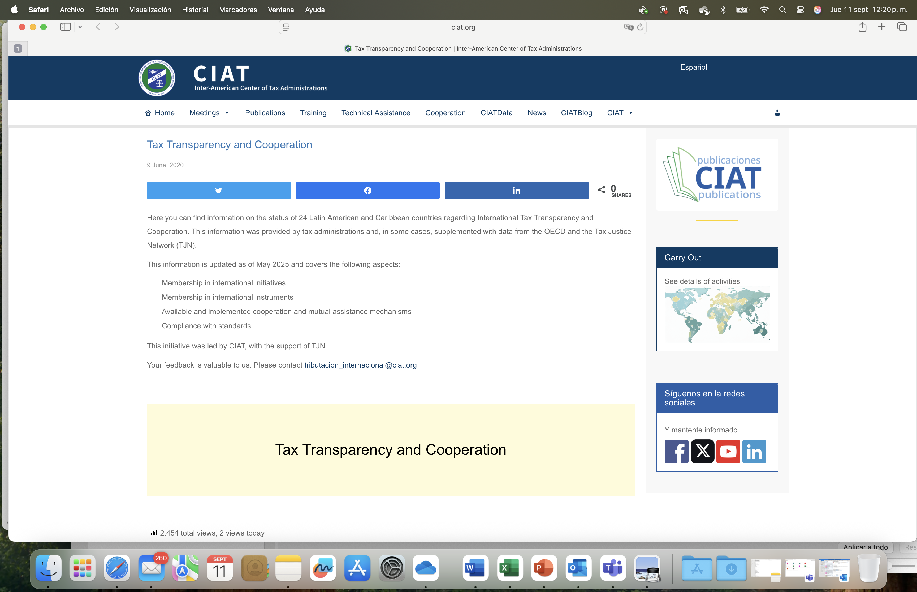

Slide 10
Cooperation with Tax Advisors or intermediaries

Slide 11
What tax advisors are looking for?
Transparency
Certainty
Better services
Efficient communication channels
What do PTOs do?
Motivate objective discussions on tax issues
Generate innovative ideas and proposals
Identify improvement opportunities
Promote transparency and voluntary compliance
Give training
Cooperation opportunity
Build bridges at regional and international level
Collect and diseminate feedback from tax advisors (improvement oportunities, ideas, challenges).
Integrate tax intermediaries in open sessions of events.
R&D
Training

Slide 12
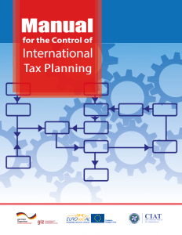
Some Results

Slide 13
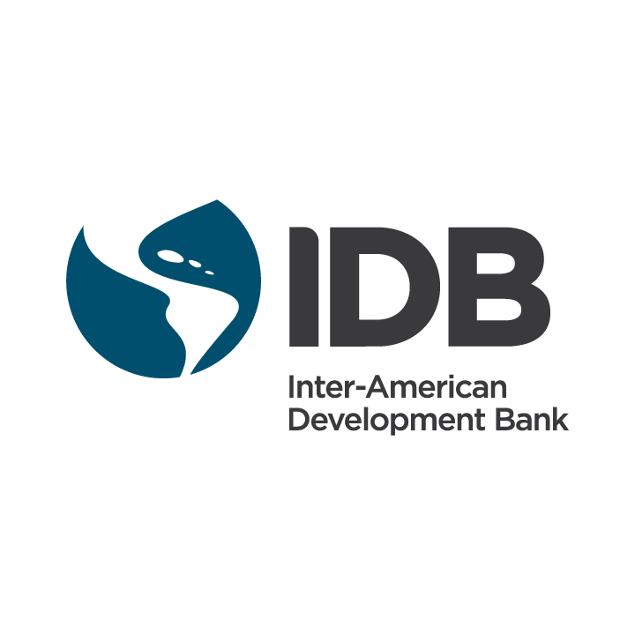

Maturity Model on the Prevention and Resolution of Disputes
Domestic and international prevention 18 indicators Domestic resolution 30 indicators International resolution 15 indicators

Slide 14
Cooperation with Companies

Slide 15
What companies are looking for?
Transparency
Certainty
Better services
Communication channels
Legal stability
Disseminate its P&S
What do PTO do?
Motivate objective discussions on tax issues
Generate innovative ideas and proposals
Identify improvement opportunities
Promote transparency
Give training
Cooperation opportunity
Build bridges at regional and international level
Collect and diseminate feedback from TA (improvement oportunities, ideas, challenges).
Learn more about value chains
R&D

Slide 16
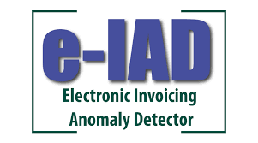
Some Results

Slide 17
Thank you so much for your attention

