Slide 1

Towards a Collaborative Framework: Policy Coherence and Joint Initiatives
WATAF Hight Level Policy Dialogue
Aziz Son, Freetown, 16 September 2025

Slide 2
Agenda
    Fundamentals of collaboration
    Cooperation challenges
    Prevention and dispute resolution mechanisms

Slide 3

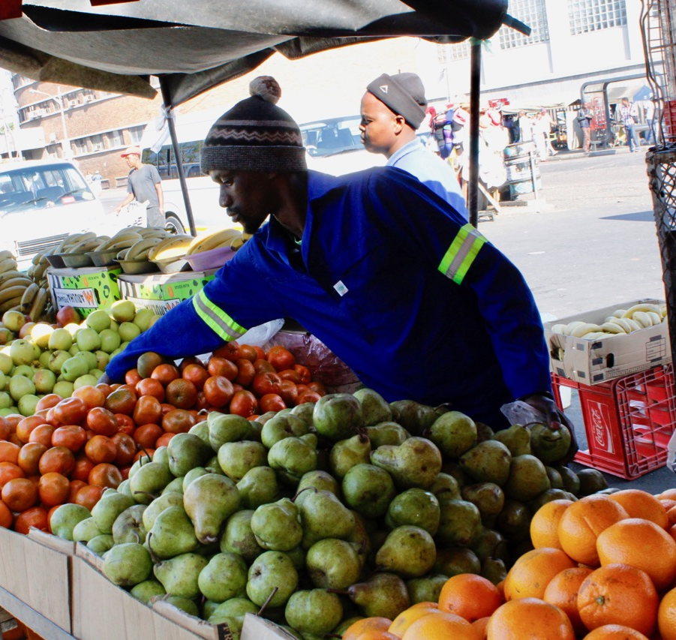
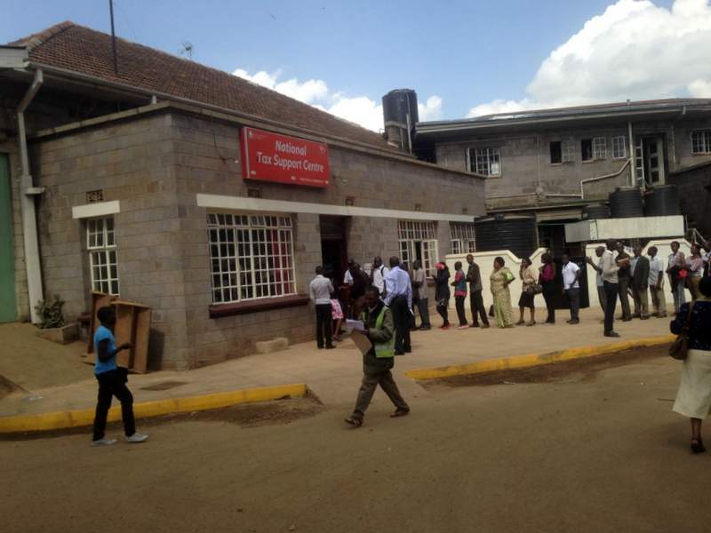
Fundamentals of collaboration - Identification of stakeholders
Collaboration requires identification of parties
    Who is your taxpayer?
    Individuals
Address
Identity - Activity
Tax registration

Slide 4

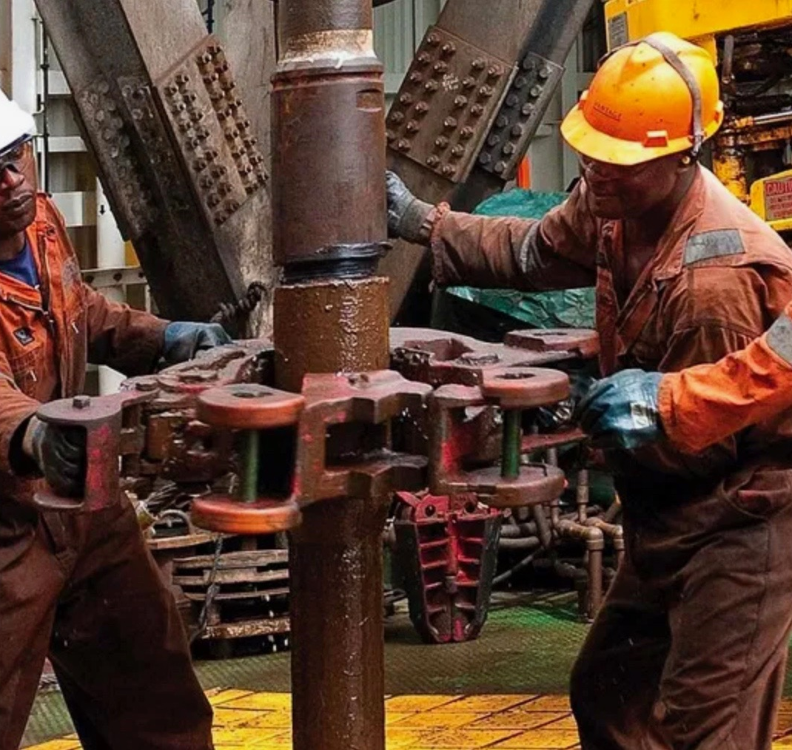
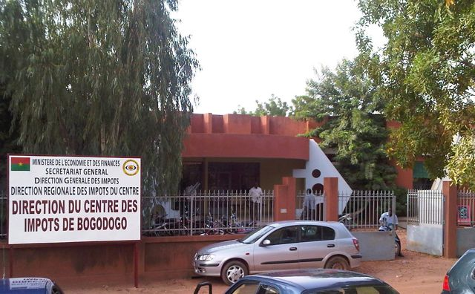
Fundamentals of collaboration – Identification of stakeholders
Collaboration requires identification of parties
    Who is your taxpayer?
    Legal entities - Companies
Headquarter - Structure
Form - Activity
Tax registration

Slide 5
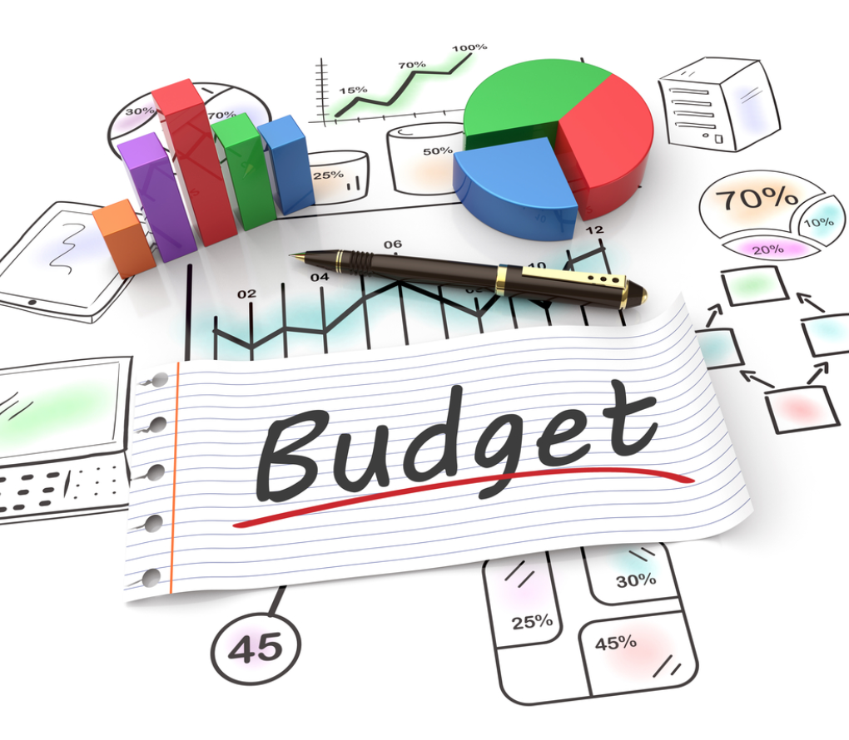
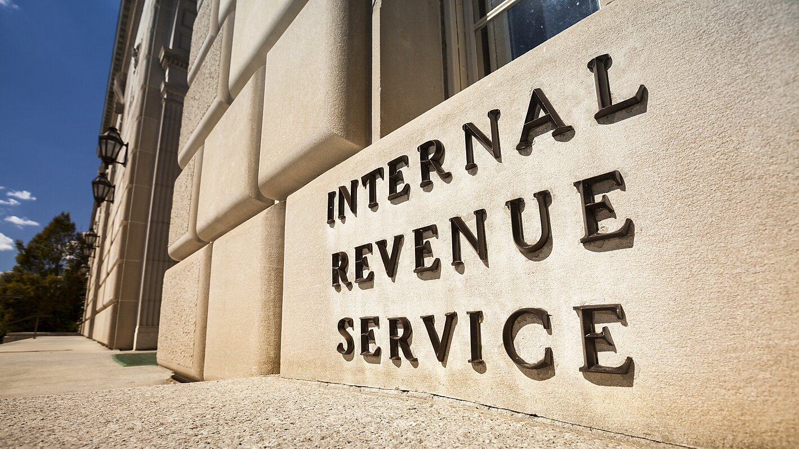
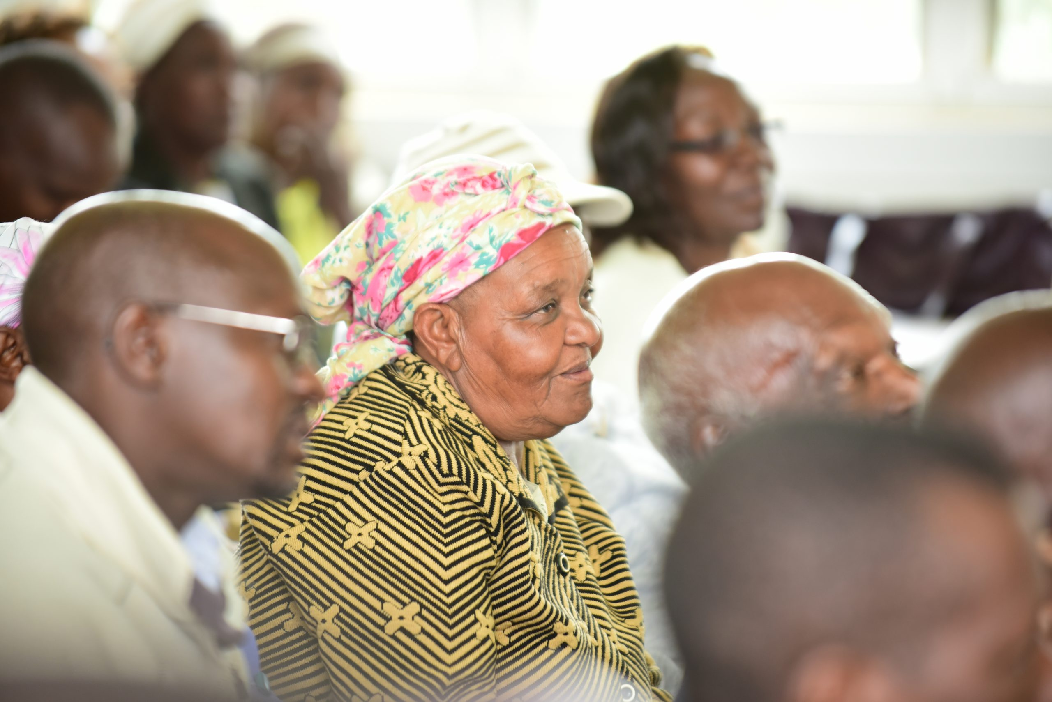
Fundamentals of collaboration - Identification of stakeholders
Collaboration requires identification of parties
    What is the role of tax administration?
    Legal entities - Companies
Tax collection
Tax registration
Enforce tax law – Manage tax compliance
Education and Assistance
Dispute resolution
Public institution

Slide 6
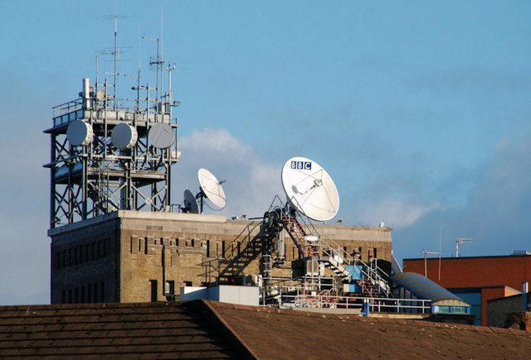
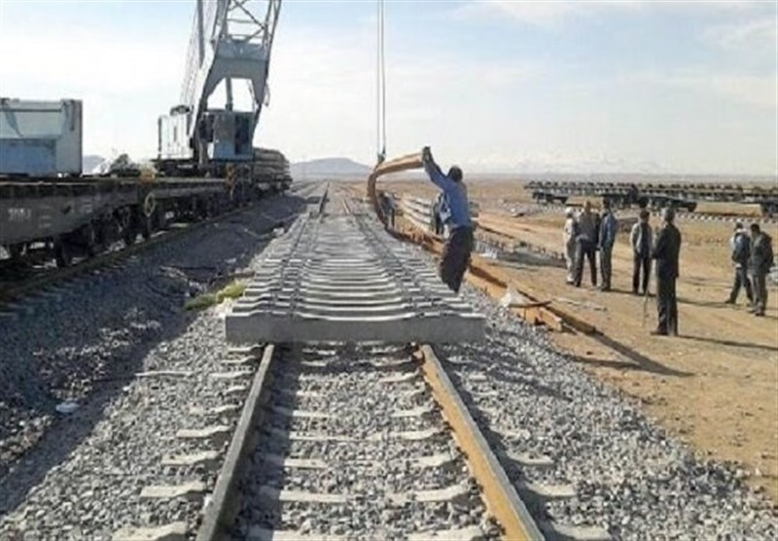

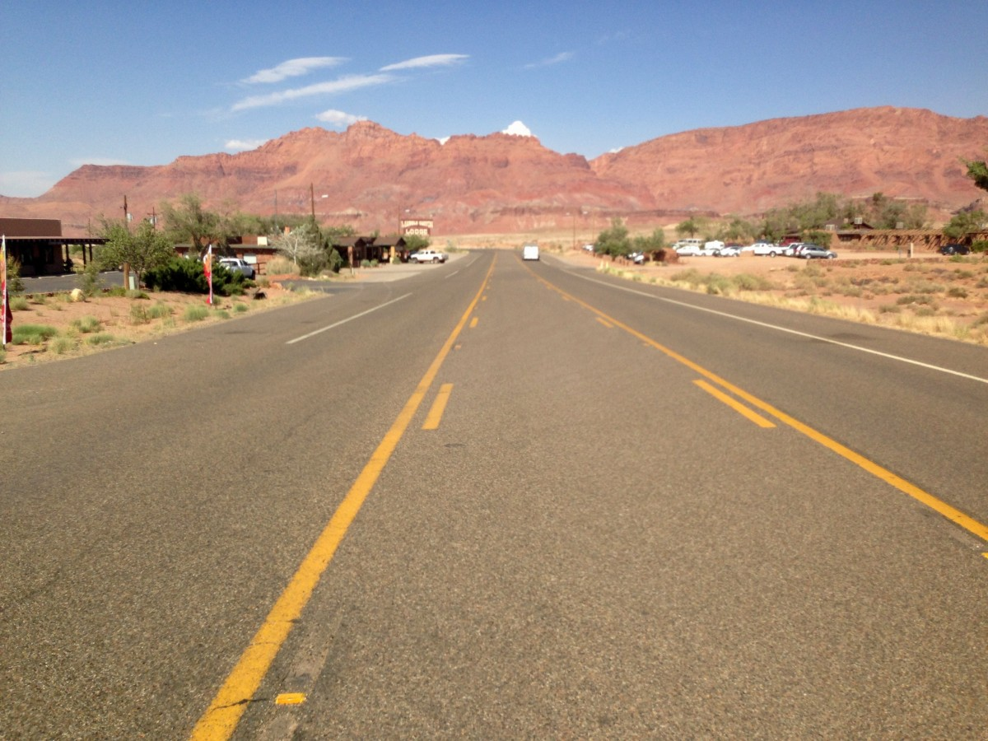

Fundamentals of collaboration – Shared goals
Tax administration
Efficient and effective tax revenue collection for State Budget
Taxpayers
Pay fair amount of tax
Collaboration involves aligning goals

Slide 7
Fundamentals of collaboration - Transparency and Building mutual trust
Collaboration relies on Clear communication
Tax administration
Taxpayers
Clear Regulations:
Clear explanation of applicable rules, and their publicity
Inform taxpayers about their rights and obligations
Fair and Consistent Enforcement: rules apply equally to all taxpayers, anti corruption mechanisms
Accessibility: online platform for filling and payment
Accountability: report on collection and public spending
Accurately reporting: truthful tax returns and documentation
Full discloser of income, assets, and financial activities: combat base erosion
Transparency in Related-Party Transactions: Ensure that all transactions are conducted at arm's length
Beneficial ownership register: combat tax evasion
Voluntary Disclosure: disclose previously undeclared income

Slide 8
    Collaboration challenges – Identification of High-risk areas
High-risk sectors
Informal sectors: Identifications of the taxpayers, assessment of the tax base,
Related entities: Tax structuring, Transfer pricing
Outbound payments: B2C service providers, (automated) digitalized services

Slide 9
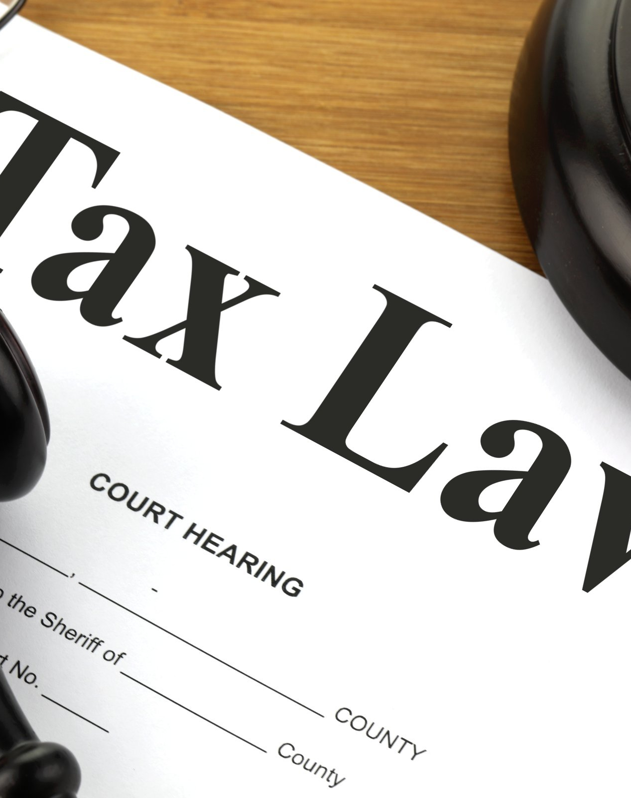
    Collaboration challenges – Legislation complexity and accessibility
Complex laws, numerous forms, and frequently changing regulations deter voluntary compliance
Challenges in determining eligibility for deductions, exemptions, or rates

Slide 10
    Collaboration challenges – Compliance issue
Inadequate (digital) Infrastructure
Poor or unreliable (e-) filing systems.
Lack of mobile-friendly platforms or offline support for rural taxpayers.
Limited integration between different government departments or databases.
Inconsistent Enforcement
Some taxpayers are aggressively audited while others go unchecked.
Large businesses or politically connected individuals may receive favorable treatment.
Perception of unfairness, reducing willingness to comply voluntarily
Cultural and Behavioral Barriers
Tax seen as a burden rather than a civic duty
Africa historical background
Resistance to formalization, especially in informal economies

Slide 11
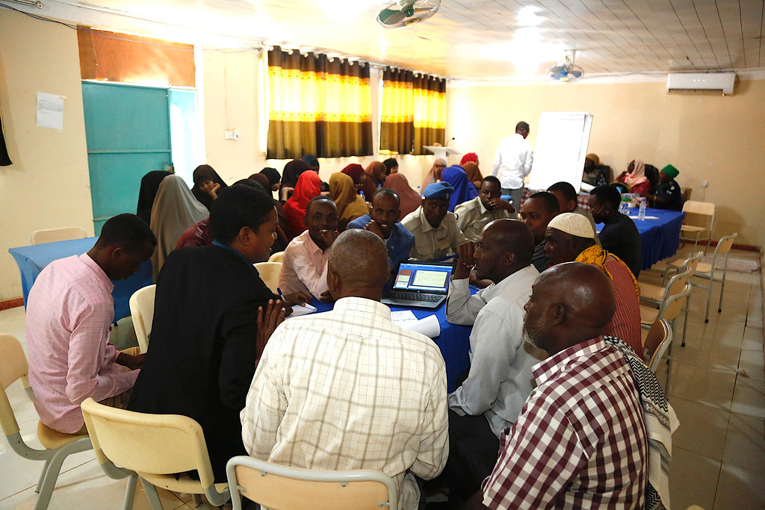
    Collaboration challenges – Prevention and dispute resolution mechanisms
Capacity building – Support and educational initiatives
Tax administration should stay up to date of new tax developments
Explain to taxpayers their tax obligations, benefits, or procedures (local languages?)
Limit fear of engaging with tax authorities

Slide 12
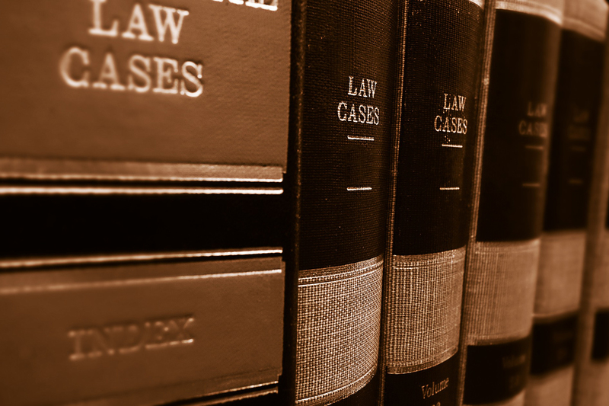
    Collaboration challenges – Prevention and dispute resolution mechanisms
Inadequate Dispute Resolution Processes
Lack of independent, easily accessible, and prompt appeal systems.
Taxpayers might hesitate to participate because of concerns about long bureaucratic procedures or unfair decisions. Publish decisions?

Slide 13
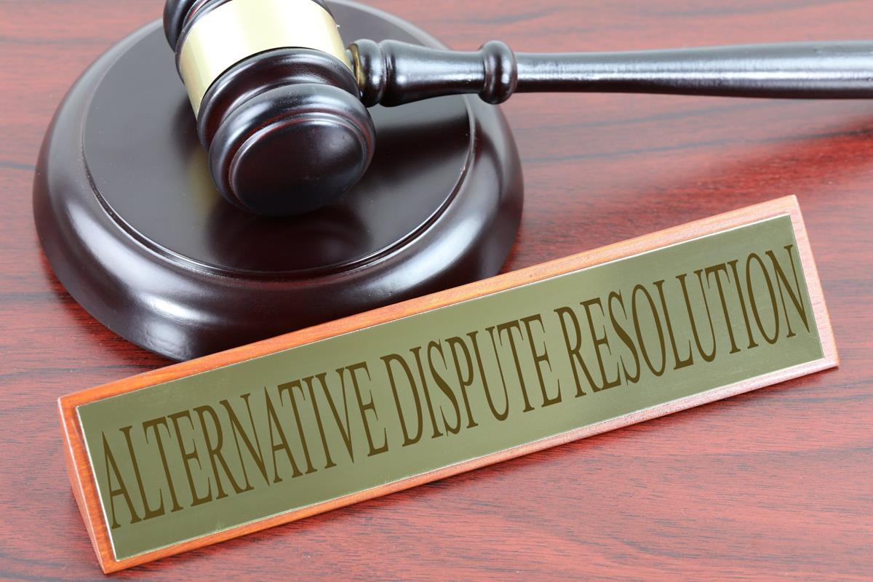
    Collaboration challenges – Prevention and dispute resolution mechanism
Alternative dispute resolution
Mediation-Conciliation-Arbitration – Include local moral authorities?
Settlement – Settle disputes by paying a fixed or negotiated amount.
Advance Pricing Agreements (APAs) – Prevent Transfer Pricing disputes
Mutual Agreement Procedure (MAP) – DTA Tax Disputes resolution mechanism
This Photo by Unknown Author is licensed under CC BY-SA

Slide 14
Thank you for your attention!
A.son@ibfd.org

